Slide 1


What’s in Your Food?
A Data-Driven Nutrient Analysis
By Alina Yildir

Slide 2
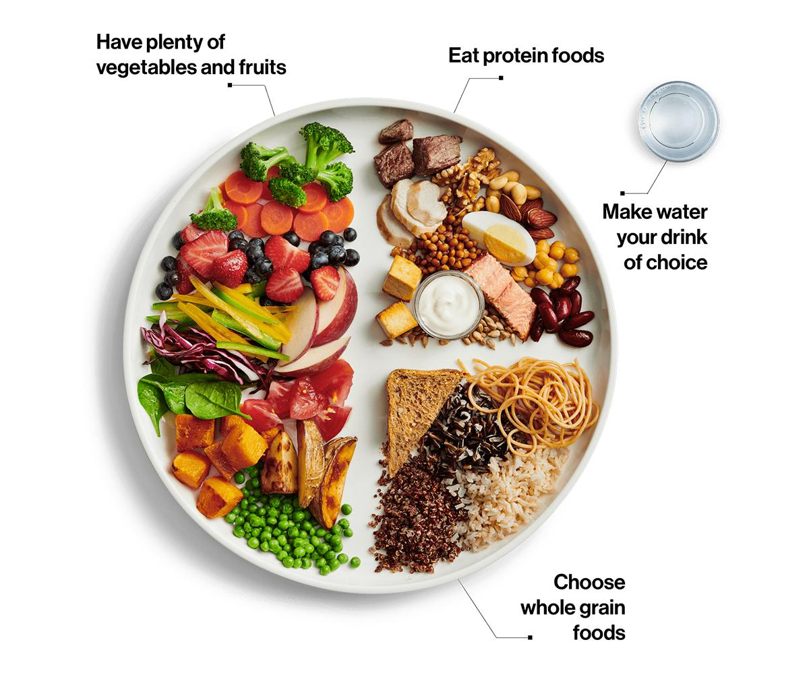
Introduction
According to Canada’s Food Guide, maintaining a balance of nutrients such as protein, fibre, carbohydrates, and potassium contributes to better overall health. At the same time, reducing the intake of saturated fat, trans fat, sugar, sodium, and cholesterol plays a key role in minimizing health risks.
Image source: Canada’s Food Guide, Government of Canada. Retrieved from https://food-guide.canada.ca/en/.

Slide 3
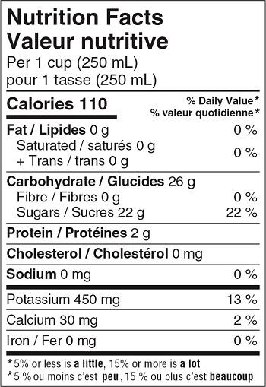
Objectives
This project features two interactive tools designed to support informed dietary choices using data from The Canadian Nutrient File.
The Tableau dashboard allows users to explore the nutritional composition of foods by selecting a nutrient of interest, analyzing food categories, subcategories, and specific foods, and comparing nutrient levels vs. calories to identify nutrient-dense options.
The AI-powered app enhances this analysis with dynamic visualizations, clustering techniques, and a chatbot, helping users find optimal food sources, manage dietary restrictions, and align with personal health goals.
Image source: Nutrition Facts Tables, Government of Canada. Retrieved from https://www.canada.ca/en/health-canada/services/food-nutrition/nutrition-labelling/nutrition-facts-tables.html.

Slide 4
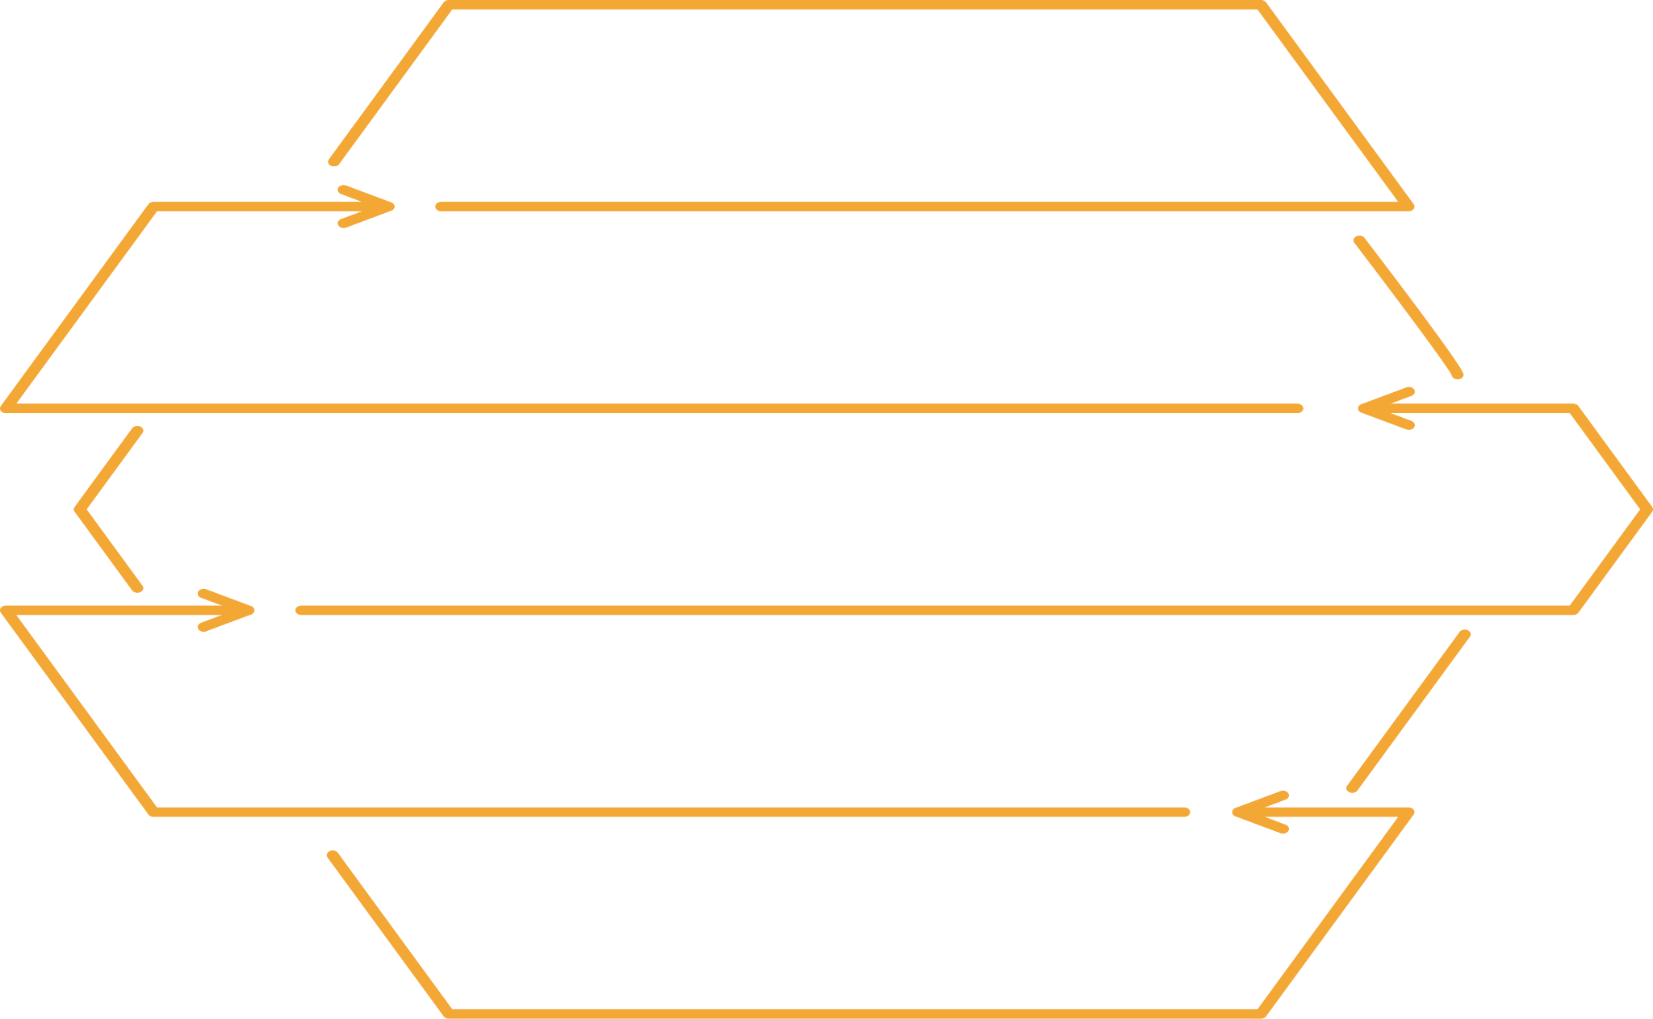

Data Preprocessing
Final Dataset: Merged into a single file
with 1,098 rows and 30 columns,
structured for analysis and visualization.
Nutrient Selection: 12 key nutrients were chosen,
values standardized per 100g,
and missing/traced values were replaced with 0.
Data Cleaning: Removed missing data, flattened headers,
and standardized nutrient names
to match the nutrition facts table format.
Raw Dataset: Originally 17 separate files,
each representing a specific food category,
requiring preprocessing.
Data Source: Based on The Canadian
Nutrient File by Health Canada, covering
19 key nutrients across 1,000+ foods.

Slide 5
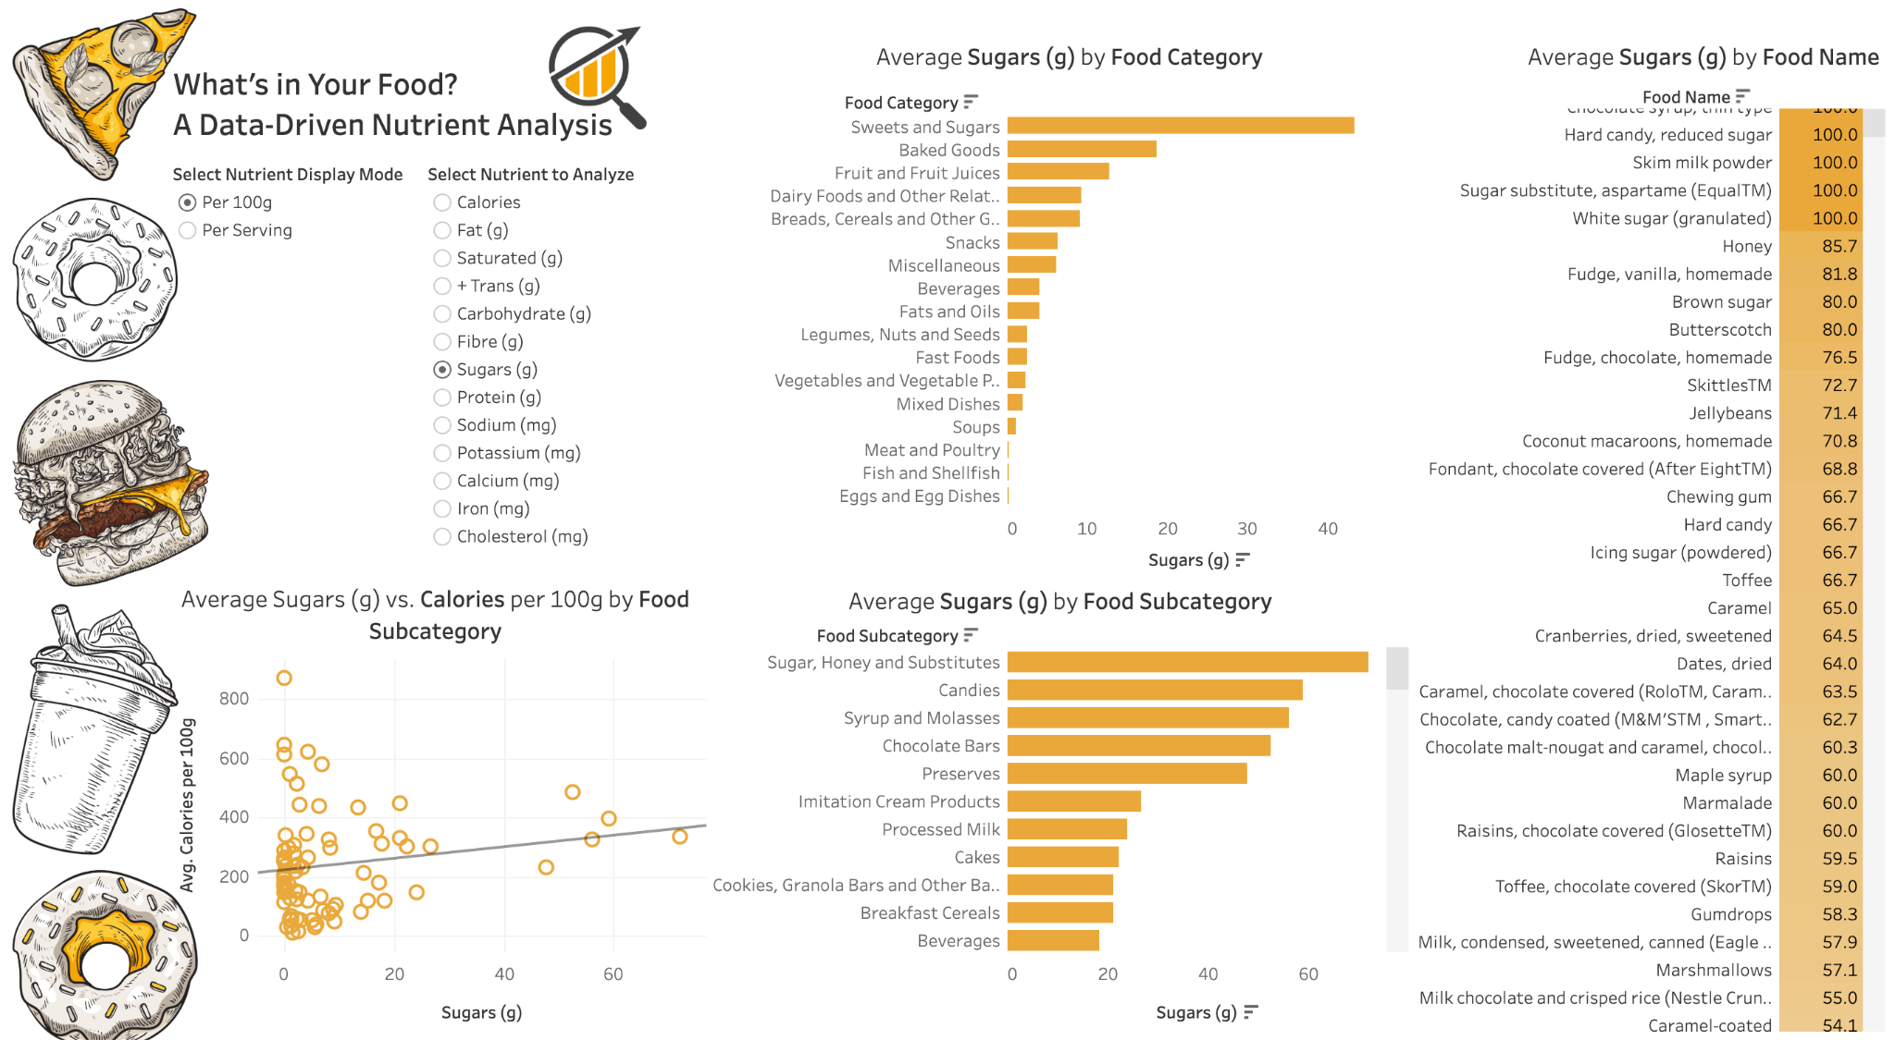
https://public.tableau.com/app/profile/alina.yildir/viz/WhatsinYourFoodAData-DrivenNutrientAnalysis/AData-DrivenNutrientAnalysis2

Slide 6

1
2
Which food subcategories have the highest nutrient density per calorie, particularly for macronutrients (carbohydrates, protein, and fat)?
df['Protein per Calorie'] = df['Protein (g)'] / df['Calories']
df['Fat per Calorie'] = df['Fat (g)'] / df['Calories']
df['Carbohydrate per Calorie'] = df['Carbohydrates (g)'] / df['Calories']
nutrient_density = df[['Food Subcategory', 'Protein per Calorie', 'Fat per Calorie', 'Carbohydrate per Calorie']].groupby('Food Subcategory').mean().reset_index()
4
3
Food Subcategory Protein per Calorie Fat per Calorie Carbohydrate per Calorie
Baked Goods 0.0151 0.0151 0.0957
Beverages 0.0039 0.0039 0.0788
Fish 0.0254 0.0187 0.0021
Nuts 0.0148 0.0448 0.0059
Vegetables 0.0093 0.0032 0.0853
Food subcategories with the highest nutrient density per calorie, particularly for macronutrients, are:
Carbohydrates: Vegetables and Fruit subcategories provide high carbohydrate content, primarily from dietary fibre and natural sugars, with relatively low-calorie counts, making them nutrient-dense options.
Protein: Fish, Shellfish, and Poultry and Game Birds subcategories deliver high protein with fewer calories, making them excellent choices for protein-dense foods.
Fat: Nuts, Nut Butters, and Seeds subcategories offer high levels of healthy fats, along with essential nutrients, while maintaining a balanced calorie-to-nutrient ratio.
https://yildiramdsa-nutrient-composition--csv-chatbotcsv-chatbot-kdmzcd.streamlit.app

Slide 7

References
Government of Canada. (n.d.). Canada’s food guide. Retrieved from https://food-guide.canada.ca/en/.
Government of Canada. (n.d.). Nutrition facts tables. Retrieved from https://www.canada.ca/en/health-canada/services/food-nutrition/nutrition-labelling/nutrition-facts-tables.html.
Government of Canada. (n.d.). Canadian nutrient file. Retrieved from https://open.canada.ca/data/en/dataset/a289fd54-060c-4a96-9fcf-b1c6e706426f.

Slide 8

Thank You for Your Attention!

